Slide 1
CS3391 Object Oriented Programming
Dr.D.Sivaganesan, Professor, PSGiTech / CSE
CS3391Object Oriented Programming Dr.D.Sivaganesan and N.Aravindhraj PSGiTech / CSE
1

Slide 2
Multitasking
Executing several tasks simultaneously is called multi-tasking.
Thread:
A thread is a single sequential (separate) flow of control within program.
Sometimes, it is called an execution context or light weight process.
Multithreading
Multithreading is a conceptual programming concept where a program (process) is divided into two or more subprograms (process), which can be implemented at the same time in parallel.
A multithreaded program contains two or more parts that can run
concurrently.
Each part of such a program is called a thread, and each thread defines a separate path of execution.
CS8392 Object Oriented Programming
Dr.D.Sivaganesan and N.Arvaindhraj PSGiTech / CSE
2

Slide 3
There are 2 types of multi-tasking
Process-based multitasking
Thread-based multi-tasking
Process-based multi-tasking
Executing various jobs together where each job is a separate independent operation is called process-based multi-tasking.
Thread-based multi-tasking
Executing several tasks simultaneously where each task is a separate independent part of the same program is called Thread-based multitasking and each independent part is called Thread. It is best suitable for the programmatic level.
CS8392 Object Oriented Programming Dr.D.Sivaganesan and N.Arvindhraj PSGiTech / CSE
3

Slide 4
A thread is a single sequential flow of control within a program.
A sequential (or single-threaded) program is one that, when executed,
has only one single flow of control.
i.e., at any time instant, there is at most only one instruction (or statement or execution point) that is being executed in the program.
A multi-threaded program is one that can have multiple flows of control when executed.
At some time instance, there may exist multiple instructions or execution points that are being executed in the program
Ex: in a Web browser we may do the following tasks at the same time:
scroll a page,
download an applet or image,
play sound,
4 print a page.
CS8392 Object Oriented Programming
Dr.D.Sivaganesan and N.Aravindhraj PSGiTech / CSE
4

Slide 5
class ABC
{
….
public void main(..)
{
…
..
}
}
begin
body
end
CS8392 Object Oriented Programming
Dr.D.Sivaganesan and N.Aravindhraj PSGiTech / CSE
5

Slide 6
Main Thread
start
start
start
Thread
Thread B
Thread
A
C
Threads may switch or exchange data/results
CS8392 Object Oriented Programming
Dr.D.Sivaganesan and N.Aravindhraj PSGiTech / CSE
6

Slide 7
threads are light-weight processes within a process
Single-threaded Process
Multiplethreaded Process
Threads of Execution
Single instruction stream
Multiple instruction stream
Common
Address Space
CS8392 Object Oriented Programming Dr.D.Sivaganesan and N.Aravindhraj PSGiTech / CSE
7

Slide 8

Server Process
Client 1 Process
Internet
Server
Threads
Client 2 Process
CS8392 Object Oriented Programming
Dr.D.Sivaganesan and N.Aravindhraj PSGiTech / CSE
8

Slide 9

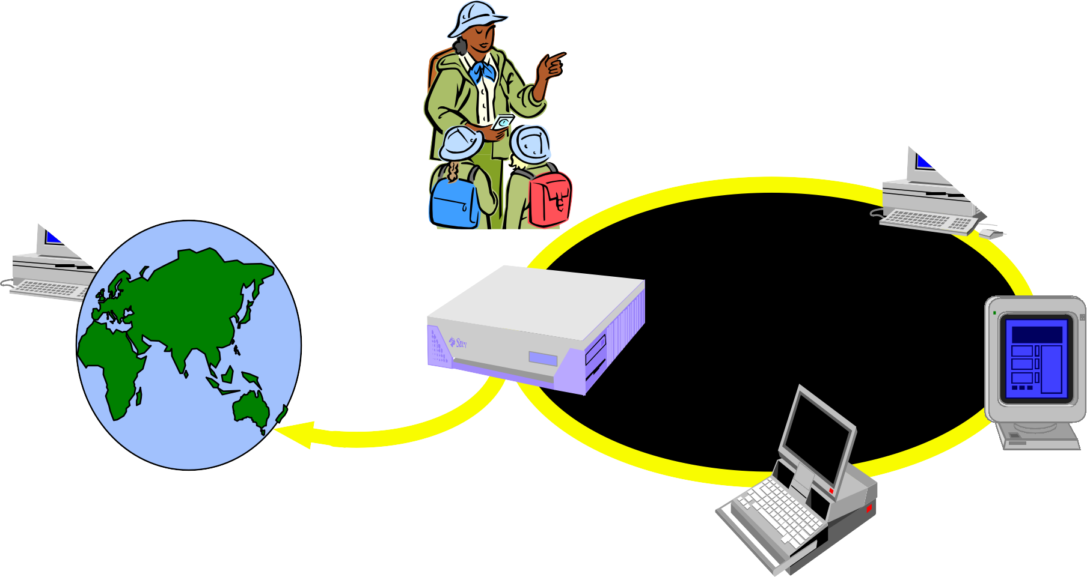

PC client
Internet
Server
Local Area Network
PDA
CS8392 Object Oriented Programming Dr.D.Sivaganesan and N.Aravindhraj PSGiTech / CSE
9

Slide 10







Printing Thread
Editing Thread
CS8392 Object Oriented Programming
Dr.D.Sivaganesan and N.Aravindhraj PSGiTech / CSE
10

Slide 11
Multithreading | Multitasking
Multithreading is to execute multiple threads in a process concurrently. | Multitasking is to run multiple Processes on a computer concurrently.
In Multithreading, the CPU switches between multiple threads in the same process. | In Multitasking, the CPU switches between multipleprocesses to complete the execution.
In Multithreading, resources are shared among multiple threads in a process. | In Multitasking, resources are shared among multiple processes.
Multithreading is light-weight and easy to create. | Multitasking is heavy-weight and harder to create.
CS8392 Object Oriented Programming
Dr.D.Sivaganesan and N.Aravindhraj PSGiTech / CSE
11

Slide 12
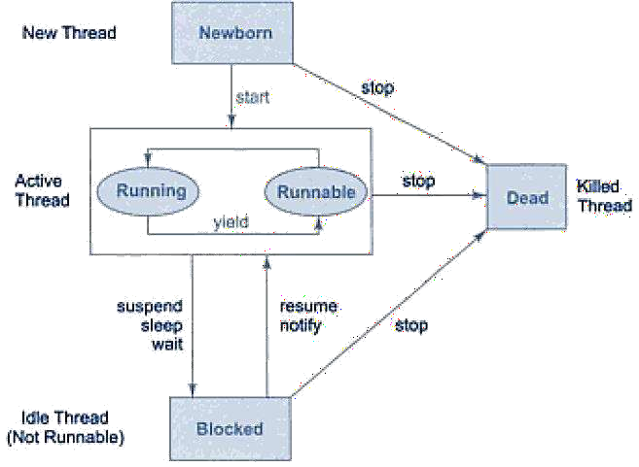
Life Cycle of Thread
Thread available in the package : java.lang.Thread
A thread can be in any of the five following states
Newborn
Running
Runnable
Blocked
Dead
CS8392 Object Oriented Programming
Dr.D.Sivaganesan and N.Aravindhraj PSGiTech / CSE
12

Slide 13
Newborn State:
When a thread object is created a new thread is born and said to be in Newborn state.
Runnable State:
If a thread is in this state it means that the thread is ready for execution and waiting for the availability of the processor. If all threads in queue are of same priority then they are given time slots for execution in round robin fashion
Running State:
It means that the processor has given its time to the thread for execution. A thread keeps
running until the following conditions occurs
Thread give up its control on its own and it can happen in the following situations
i.A thread gets suspended using suspend() method which can only be revived with resume()
method
ii.A thread is made to sleep for a specified period of time using sleep(time) method, where
time in milliseconds
iii.A thread is made to wait for some event to occur using wait () method. In this case a thread
can be scheduled to run again using notify () method.
iv.A thread is pre-empted by a higher priority thread
Blocked State:
If a thread is prevented from entering into runnable state and subsequently running state,
then a thread is said to be in Blocked state.
Dead State:
A runnable thread enters the Dead or terminated state when it completes its task or otherwise
CS8392 Object Oriented Programming
Dr.D.Sivaganesan and N.Aravindhraj PSGiTech / CSE
13

Slide 14
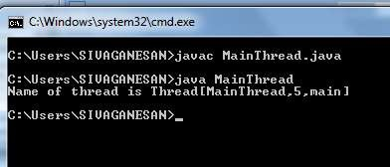
The Main Thread
When we run any java program, the program begins to execute its code starting
from the main method.
Therefore, the JVM creates a thread to start executing the code present in main
method. This thread is called as main thread.
Although the main thread is automatically created, you can control it by obtaining a
reference to it by calling currentThread() method.
Two important things to know about main thread are,
It is the thread from which other threads will be produced.
main thread must be always the last thread to finish execution.
Class MainThread
{ public static void main(String[] args)
{ Thread t1=Thread.currentThread();
t1.setName("MainThread");
System.out.println("Name of thread is "+t1);
}}
CS8392 Object Oriented Programming
Dr.D.Sivaganesan and N.Aravindhraj PSGiTech / CSE
14

Slide 15

There are two ways to create our own Thread object
Subclassing the Thread class and instantiating a new object of that class
Implementing the Runnable interface
In both cases the run() method should be implemented

Slide 16

public class ThreadExample extends Thread { public void run () {
for (int i = 1; i <= 100; i++) { System.out.println(“Thread: ” + i);
}
}
}

Slide 17
void start()
Creates a new thread and makes it runnable
This method can be called only once
void run()
The new thread begins its life inside this method
void stop() (deprecated)
The thread is being terminated
yield()
Causes the currently executing thread object to temporarily pause and
allow other threads to execute
Allow only threads of the same priority to run
sleep(int m)/sleep(int m,int n)
The thread sleeps for m milliseconds, plus n nanoseconds

Slide 18
public class RunnableExample implements Runnable
{
public void run () {
for (int i = 1; i <= 100; i++) { System.out.println (“Runnable: ” + i);
}
}
}

Slide 19

class ThreadEx1 {
public static void main(String [] args ) { ThreadExample t = new ThreadExample(); t.start();
}
}

Slide 20
class ThreadSample implements Runnable {
public void run()
{ Try {
for (int i = 5; i > 0; i--)
{System.out.println("Child Thread" + i);
Thread.sleep(1000);
}}
catch (InterruptedException e)
{System.out.println("Child interrupted");
}
System.out.println("Exiting Child Thread");
}}
public class exthread
{ public static void main(String[] arg)
{
ThreadSample d = new ThreadSample(); Thread s = new Thread(d); s.start();
try
{ for (int i = 5; i > 0; i--)
{
System.out.println("Main Thread" + i);
Thread.sleep(5000);
} }
catch (InterruptedException e)
{
System.out.println("Main interrupted");
}
System.out.println("Exiting Main Thread");}}
CS8392 Object Oriented Programming
Dr.D.Sivaganesan and N.Aravindhraj PSGiTech / CSE
20

Slide 21
class ThreadSample extends Thread { public void run()
{ try
{ for (int i = 5; i > 0; i--)
{ System.out.println("Child Thread" + i);
Thread.sleep(1000);
}
}
catch (InterruptedException e)
{
System.out.println("Child interrupted");
}
System.out.println("Exiting Child Thread");
}}
public class exthread2
{ public static void main(String[] arg)
{ ThreadSample d = new ThreadSample(); d.start();
try
{ for (int i = 5; i > 0; i--)
{ System.out.println("Main Thread" + i);
Thread.sleep(5000); }}
catch (InterruptedException e)
{ System.out.println("Main interrupted"); } System.out.println("Exiting Main Thread"); }}
CS8392 Object Oriented Programming
Dr.D.Sivaganesan and N.Aravindhraj PSGiTech / CSE
21

Slide 22
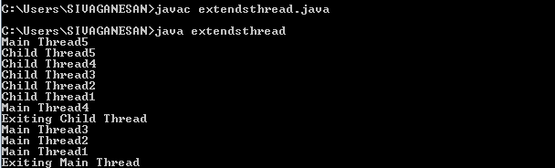
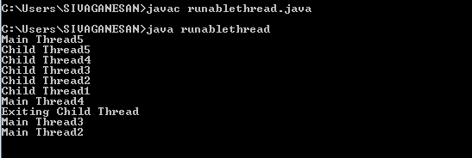
CS8392 Object Oriented Programming
Dr.D.Sivaganesan PSGiTech / CSE
22

Slide 23

CS8392 Object Oriented Programming
Dr.D.Sivaganesan and N.Arvindhraj PSGiTech / CSE
23

